Slide 1

Ransomware
Presenter Name

Slide 2
Agenda
INTRODUCTION & STRATEGY
THE EVENT; SCENARIO BASED EXERCISE
Break(s)
RECAP/REVIEW/ACTION ITEMS
FEEDBACK DISCUSSION

Slide 3

Objectives
Coordination: Improve the coordination among the various members of Crisis Team.
Communications: Evaluate the communication process among team members and with other groups.
Decision Making: Assess the decision-making processes and activation of the team.

Slide 4

Considerations
This is a training & learning exercise (not a test) so lets keep it fun and positive!
All participant thoughts and ideas are encouraged….please speak up! There are no hidden agendas or trick questions. There may be more than one response to the crisis.
Log all activities, best to appoint a scribe.

Slide 5

The event
Ransomware

Slide 6

Scenario
Wednesday November 18th
75% of employees are working remotely
The benefits renewal and sign up period is full swing

Slide 7
The Incident begins 8:45am
Remote employees are noticing a slower than usual connection through VPN. In some cases, remote workers are unable to log in
Several remote employees are emailing support, reporting that they are having issues with their soft phone working. Unfortunately emails are not being delivered.
Clients are calling the support line reporting difficulties accessing their accounts through the web site

Slide 8

Discussion
What are the first thoughts and reactions?
Is there a process or plan in place for this type of situation?
Who becomes the point person to manage this situation? Is there a team?

Slide 9
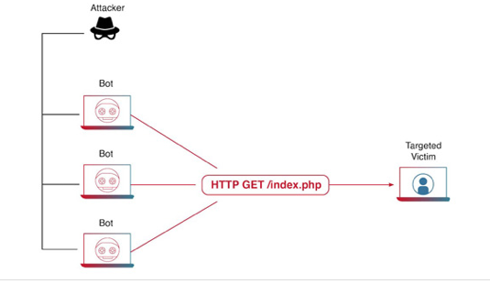
Scenario update 9:10am
The IT Networking Team has noticed an increase of network traffic and raise an incident ticket to report the issue.
Simultaneously, several employees working remotely are now complaining that they can no longer access the employee portal using the internet.
Your Information Security Manager realizes that the there is a Distributed Denial of Services attack (“Ddos attack”) taking place.

Slide 10

Discussion
Knowing what you know, what is the level of communication internally? Externally?
What actions is the IT team taking to manage the Ddos attack?
As the Ddos attack is affecting remote computing for employees and access to the website for clients, what protocols are in place to manage the situation?
Is there concern about the company’s reputation to the public?

Slide 11

Scenario – 11:25am
While resolving issues caused by the Ddos attack, the IT team discovers a ransom demand on the Enterprise Data Warehouse Server.
The server that hosts all of client personal information has been compromised and files have been encrypted.
A group is demanding 2 million dollars in bitcoin in exchange for the encryption key –if their demand are not met, they are threatening to share the information on the dark web.

Slide 12
Discussion
There are now multiple events occurring. How are you managing each situation? (Member concerns, Ddos attack, ransom demand)
What are the tactical and strategic issues?
Has this incident be reported to law enforcement? Who is responsible for that outreach?
Are there third-party resources and vendors involved and contributing to the solution?
What is the current messaging to:
Employees
    Clients
  Leadership
  Media and Regulators

Slide 13

Scenario 2:30pm
Your Information Security team has been able to restore 96% functionality caused by the Ddos attack.
Most remote workers have resumed daily work cadence.
Because of the ransomware on the Enterprise Data Warehouse Server, all data stored on that server is inaccessible; Reports cannot be run, information cannot be retrieved and any application associated with these databases will experience limited to no functionally

Slide 14
Discussion
Your Information Security team has been able to restore 96% functionality caused by the Ddos attack.
Most remote workers have resumed daily work cadence.
Because of the ransomware on the Enterprise Data Warehouse Server, all data stored on that server is inaccessible; Reports cannot be run, information cannot be retrieved and any application associated with these databases will experience limited to no functionally

Slide 15
Scenario update
The IT team discovers that the bad actors were able to infiltrate the network by compromising a remote users home router.
By stealing credentials from the user, they were able to bypass external security by using a cloned VPN client. Once they gained access, they moved laterally through the system.
Once they reached administrative level, the bad actors were able to gain direct access to critical servers.
The discussion of how to deal with the ransomware on the Enterprise Data Warehouse Server continues….

Slide 16
Discussion
With the knowledge of how the Actor hacked into your network, what preventive steps will you implement?
  Are there lessons learned in regard to the loss of VPN, Customer facing web site, VOIP phones?
  What is the procedure for addressing the ransomware attack?

Slide 17
Recap/review / actions items
What have you learned during this exercise?
Please identify positive strengths that you observed during the exercise and/or discussion.
Please identify areas for improvement regarding the exercise, response plans, decision-making processes, etc.
What next steps have we identified for the group?
    prioritize short-term and long-term follow-up actions.

Slide 18

Thank you

